Slide 1
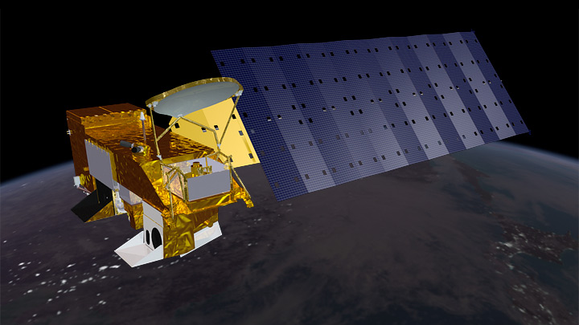
Chiba Campaign 2022 MODIS-Terra(10:30) 550nm AOD Saiei 2022-11-27
Giovanni The Bridge Between Data and Science v 4.37
NASA earth observatory

Slide 2
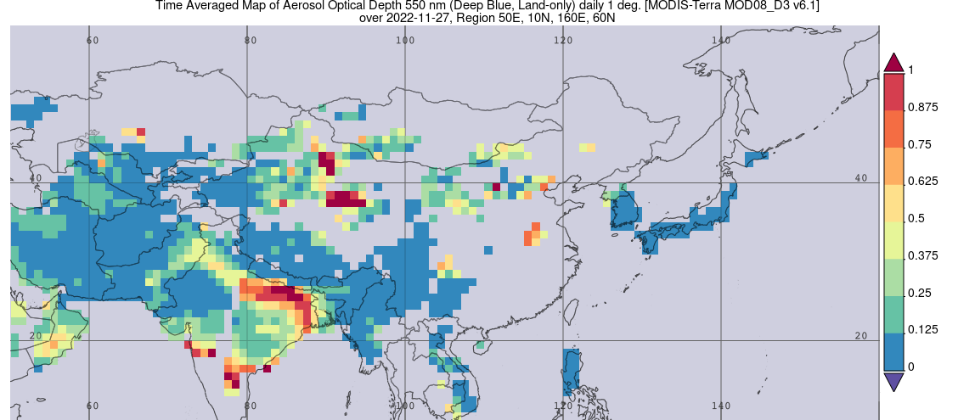
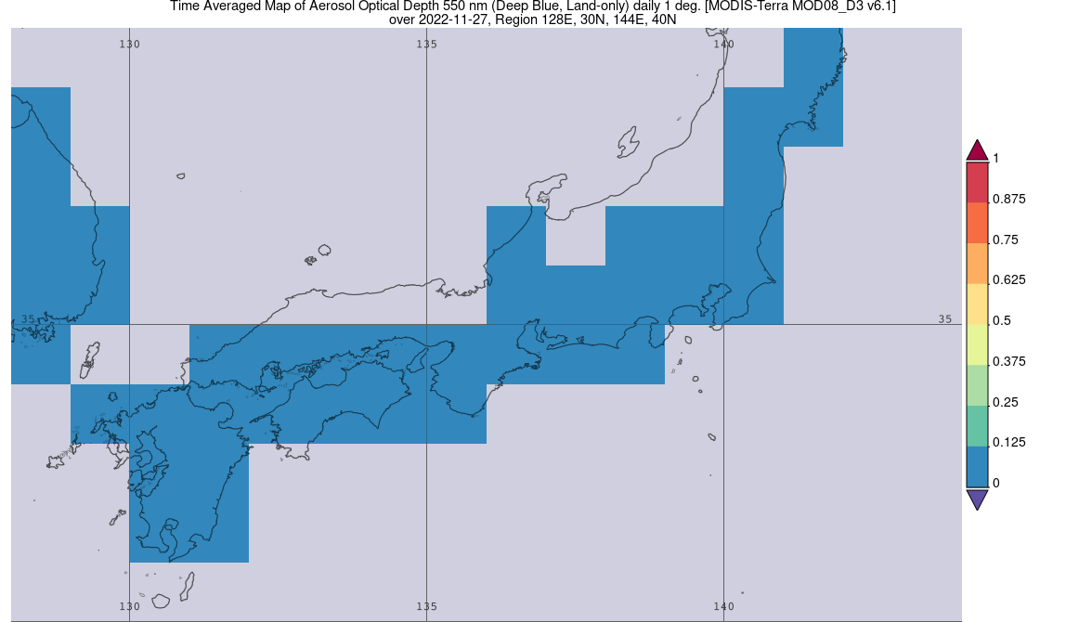
Asia
Land-only
2022-11-27
Japan

Slide 3
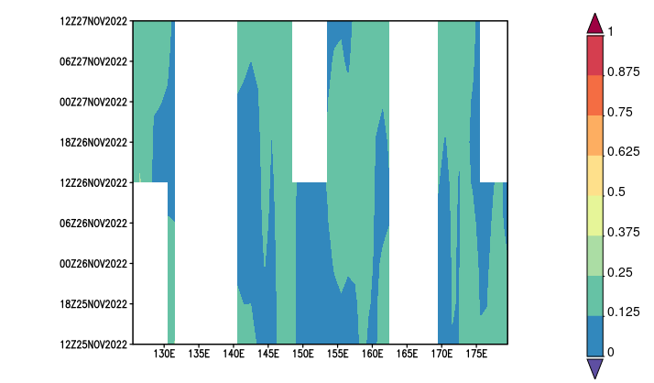
Hovmöller diagram
Latitude-Averaged(25-30N) 全AOD 550nm
2022-11-27
2022-11-25
Lon 125~180E

